Slide 1
If the Student Unions are bad for Education, Why our Universities Rank the Worst in the World
PUBLISHED ON 29TH NOV –2019
WRITTEN BY: AMMAR RASHID
THE DAWN

Slide 2
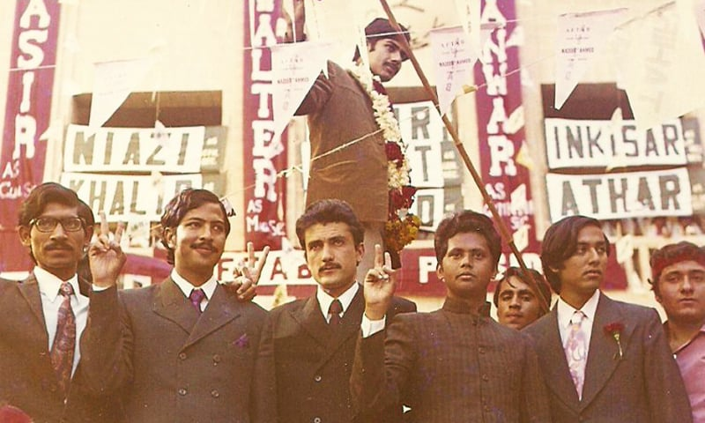
THE MURDER OF PAKISTAN’S STUDENT UNION
In 1984, General Zia-ul-Haq imposed a ban on student unions in all colleges throughout the country (though in Sindh, forming student unions was already made illegal in 1979).
Its been 35 years since the ban of student union.

Slide 3
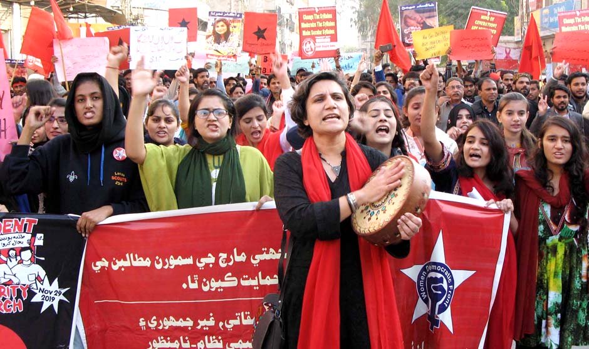
Student Solidarity March
More than 30,000 students took part in the student solidarity march on 29th November 2019, to demand major reforms of educational system

Slide 4
Campus politics cultivates leaders. The ban is the reason why Pakistan lacks seasoned leaders, and why our parliament and universities ineffective today

Slide 5
Rafiq Jan Jibran from Gomal University in KPK says that “Student unions are a constitutional right –They are the wings of political parties.” Jibran adds that “When students are stripped of their right to unions, “They become frustrated. They lose a platform to express themselves.”

